Slide 1

Natural Language Processing
Yue Zhang
Westlake University

Slide 2
Week 4
Feature Vector Representation

Slide 3
Overview
Week 2
Overview of NLP architecture
Data and Model
Review of background
Linear Models
Week 3
Week 4
Week 5
Week 6
Week 7
N-gram Language Models
Naïve Bayes
Generative Text Classification
Features
Document Representation
Discriminative Text Classification
Neuron
SGD
Entropy, Perplexity
Word Representation
HMM -- Generative Sturctured Prediction
CRF – Discriminative Structured Prediction
Neural Models
Week 8
Week 10
Week 12
MLP, Multi-Layer Perception
Neural N-gram LM and Word Embedding
Neural Structured Prediction
Sequence-to-sequence
Neural Recurrent Language Models
Week 9
Week 13
Sequence Representation
Neural Text Classification
Week 11
Sequence-level Pre-training
Pre-trained Models for Text Classification and other NLP tasks
Structured Representation
Large Language Models
Week 14
Week 15
Scaling, instruction following and LLMs
LLMs for NLP, AGI and beyond

Slide 4
Goal
Learn feature vector representation
Learn what we can do using feature vectors
Learn the difference between discriminative models and generative models
Clustering
Classification

Slide 5
Contents
4.1 Representing Documents in Vector Spaces
4.1.1 Clustering
4.1.2 K-Means Clustering
4.1.3 Classification
4.1.4 Support Vector Machine
4.1.5 Perceptron
4.2 Multi-class Classification
4.2.1 Defining Output-based Features
4.2.2 Multi-class SVM
4.3.3 Multi-class Perceptron
4.3 Discriminative Models and Features
4.3.1 Discriminative Models and Features
4.3.2 Dot-product Form of Linear Models
4.3.3 Separability and Generalizability
4.3.4 Dealing with Non-linearly-separable data

Slide 6
Contents
4.1 Representing Documents in Vector Spaces
4.1.1 Clustering
4.1.2 K-Means Clustering
4.1.3 Classification
4.1.4 Support Vector Machine
4.1.5 Perceptron
4.2 Multi-class Classification
4.2.1 Defining Output-based Features
4.2.2 Multi-class SVM
4.3.3 Multi-class Perceptron
4.3 Discriminative Models and Features
4.3.1 Discriminative Models and Features
4.3.2 Dot-product Form of Linear Models
4.3.3 Separability and Generalizability
4.3.4 Dealing with Non-linearly-separable data

Slide 7
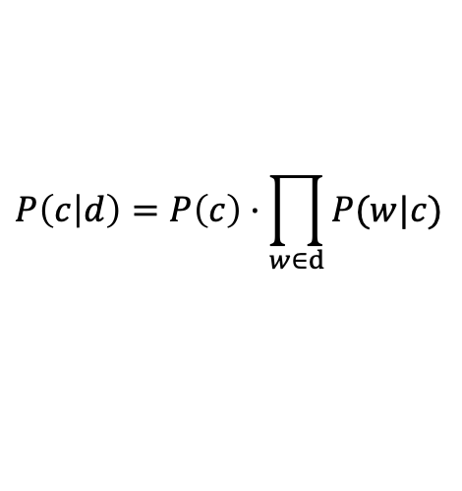
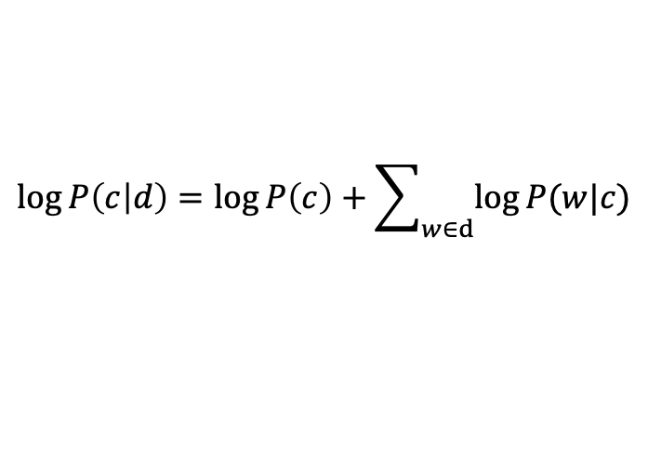
Review Naïve Bayes
$$P\left(c | d\right)=P\left(c\right)·\prod_{w∈d}{P(w|c)}$$
$$\log{P\left(c | d\right)}=\log{P\left(c\right)}+\sum_{w∈d}{\log{P(w|c)}}$$

Slide 8
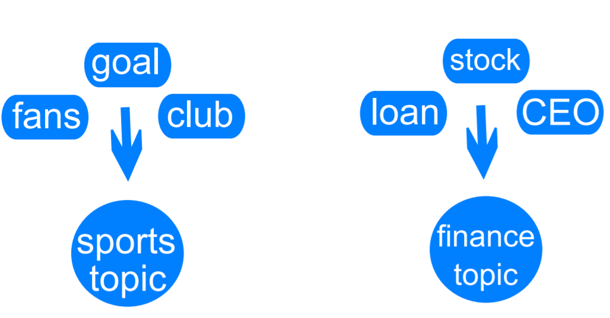
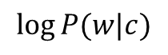
Review Naïve Bayes
$$P\left(c | d\right)=P\left(c\right)·\prod_{w∈d}{P(w|c)}$$
$$\log{P\left(c | d\right)}=\log{P\left(c\right)}+\sum_{w∈d}{\log{P(w|c)}}$$
Words as features to represent documents
$$\log{P(w|c)}$$

Slide 9
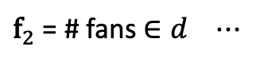
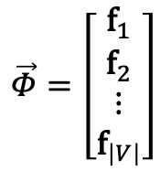
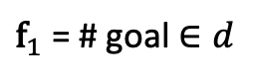
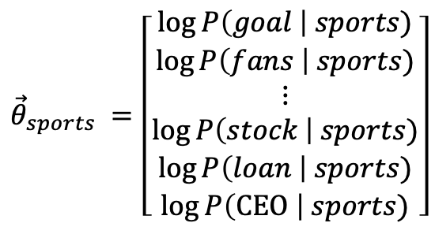
Feature Vectors
We can view NB as scoring a ($d$, $c$) pair by using a representation of $d$ and a linear scoring function with parameters specific to $c$.
$${\vec{θ}}_{sports} =\left[\begin{aligned}\begin{aligned}\log{P\left(goal \right| sports)} \\ \log{P\left(fans \right| sports)} \\ ⋮ \\ \log{P\left(stock \right| sports)} \\ \log{P\left(loan \right| sports)}\end{aligned} \\ \log{P\left(\text{CEO} \right| sports)}\end{aligned}\right]$$
$$\vec{Φ}=\left[\begin{aligned}{\text{f}}_{1} \\ {\text{f}}_{2} \\ ⋮ \\ {\text{f}}_{\left|V\right|}\end{aligned}\right]$$
${\text{f}}_{1}$ = # goal $∈d$
${\text{f}}_{2}$ = # fans $∈d$ $⋯$
$$\log{P\left(c=sports | d\right)}={\vec{θ}}_{sports}∙\vec{Φ}+\log{P\left(c=sports\right)}$$

Slide 10
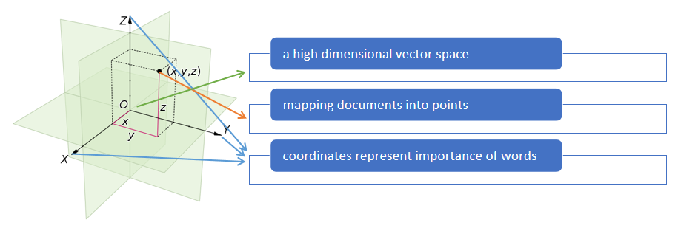
Vector Space Model
Mapping documents to vectors
(unstructured texts into mathematical structures)

Slide 11
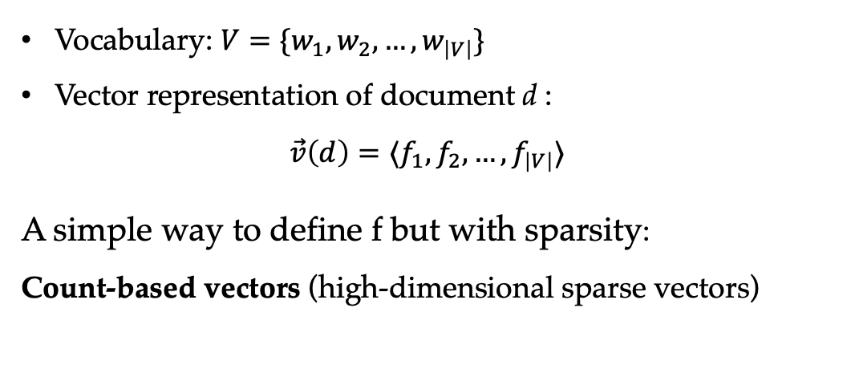
Sparse Vectors Document Representation
Vocabulary: $V=\{w_{1},w_{2},…,w_{\left|V\right|}\}$
Vector representation of document d :
$$\vec{v}\left(d\right)=⟨f_{1},f_{2},…,f_{\left|V\right|}⟩$$
A simple way to define f but with sparsity:
Count-based vectors (high-dimensional sparse vectors)

Slide 12
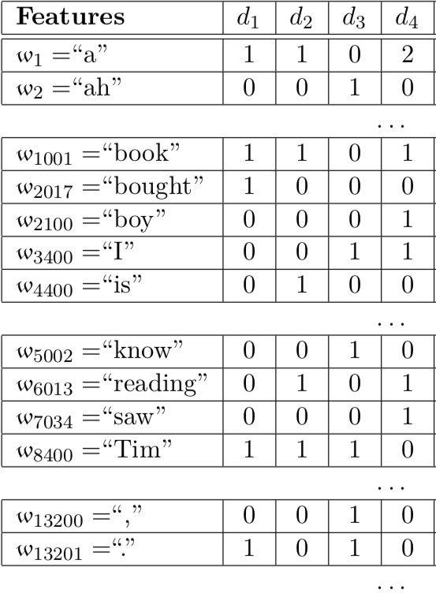
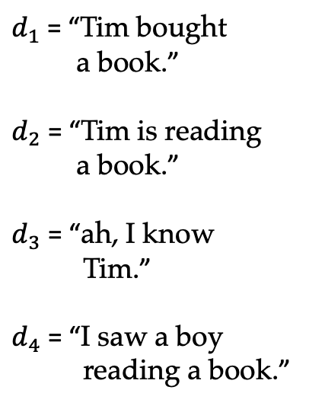
Vector Representation of Documents
Count-based vector
$d_{1}$ = “Tim bought
a book.”
$d_{2}$ = “Tim is reading
a book.”
$d_{3}$ = “ah, I know
Tim.”
$d_{4}$ = “I saw a boy
reading a book.”
Notes:
table 3.1

Slide 13
Stop Words
Frequent yet uninformative
Common stop words in English
∣ a ∣ the ∣ on ∣ of ∣ with ∣ about ∣ and ∣ in ∣ at ∣ to ∣ " ∣, ∣?∣ oh ∣ . ∣
Filter uninformative words
remove Stop Words from the vocabulary when mapping documents to vectors
Limitation
manually defined.

Slide 14
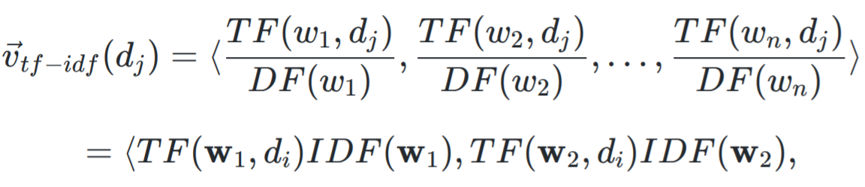
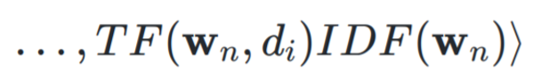
TF-IDF Vectors Document Representation
Soft version of stop words in selecting useful words.
Intuition — the more documents in which of words exists, the less informative the word is.
reduce the importance values of uninformative words

Slide 15
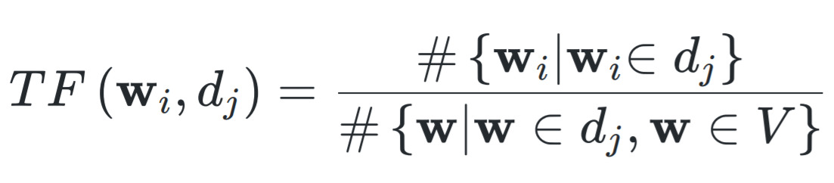
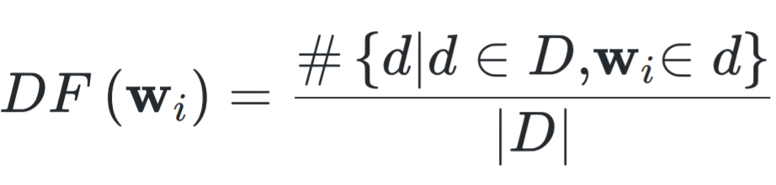
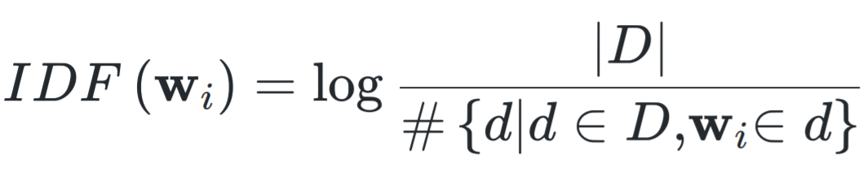
TF-IDF Vectors
Formally,
Term frequency (TF)
Document frequency (DF) and inverted document frequency (IDF)
Inverted document frequency (IDF) (with logarithm)

Slide 16
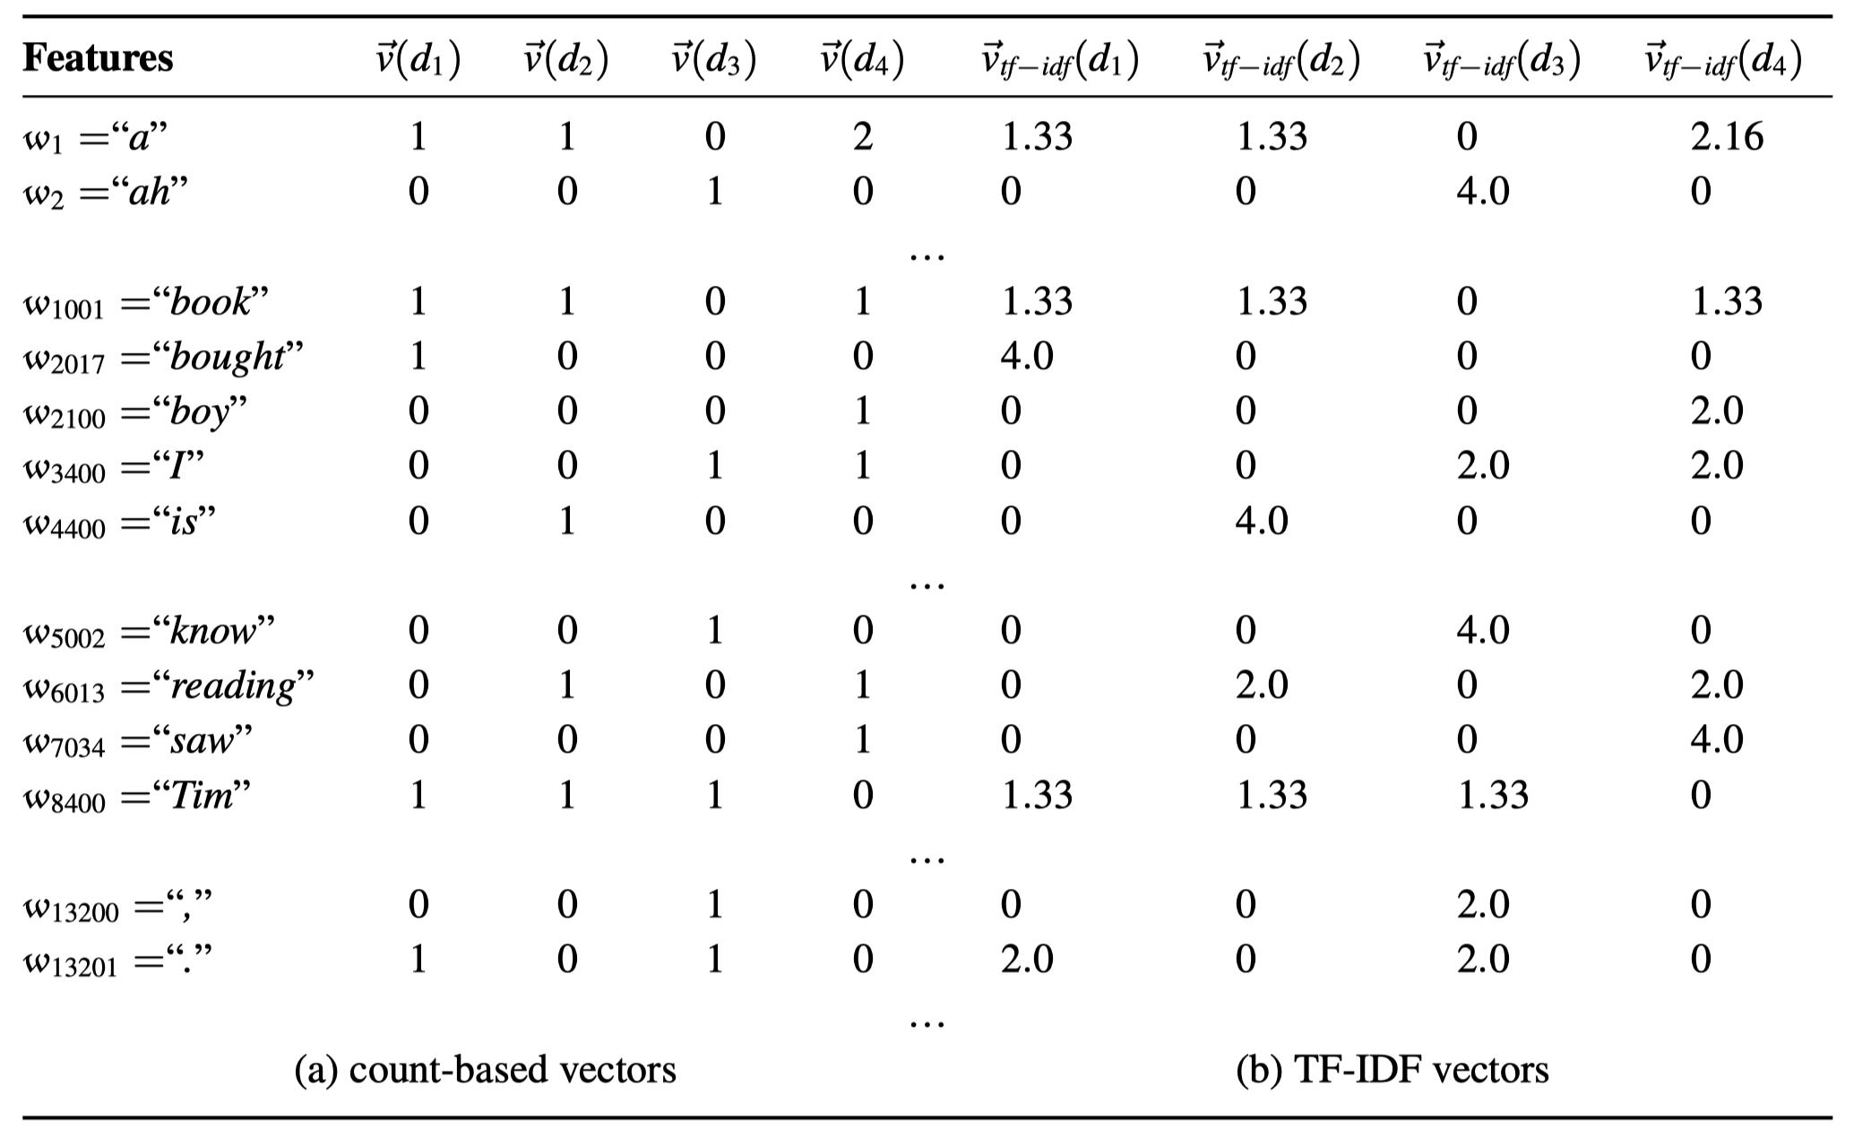
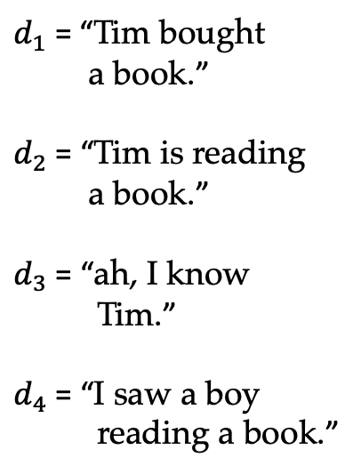
Vector Representation of Documents
$d_{1}$ = “Tim bought
a book.”
$d_{2}$ = “Tim is reading
a book.”
$d_{3}$ = “ah, I know
Tim.”
$d_{4}$ = “I saw a boy
reading a book.”
Notes:
table 3.1

Slide 17
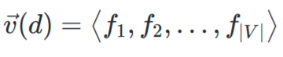
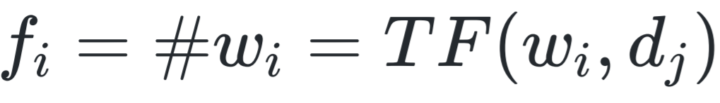
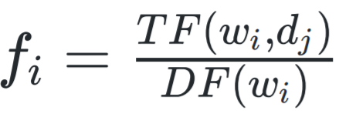
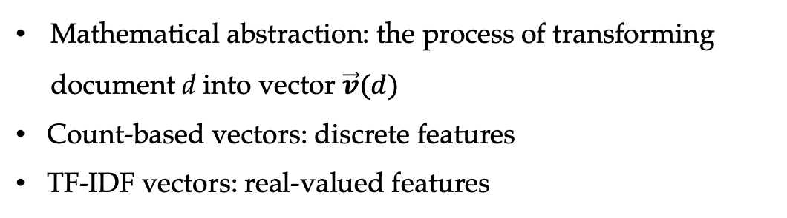
Summary
Vector representation for document d
In count-based vectors,
In TF-IDF vectors,
Feature extraction
Mathematical abstraction: the process of transforming document d into vector $\vec{v}(d)$
Count-based vectors: discrete features
TF-IDF vectors: real-valued features

Slide 18
Contents
4.1 Representing Documents in Vector Spaces
4.1.1 Clustering
4.1.2 K-Means Clustering
4.1.3 Classification
4.1.4 Support Vector Machine
4.1.5 Perceptron
4.2 Multi-class Classification
4.2.1 Defining Output-based Features
4.2.2 Multi-class SVM
4.3.3 Multi-class Perceptron
4.3 Discriminative Models and Features
4.3.1 Discriminative Models and Features
4.3.2 Dot-product Form of Linear Models
4.3.3 Separability and Generalizability
4.3.4 Dealing with Non-linearly-separable data

Slide 19
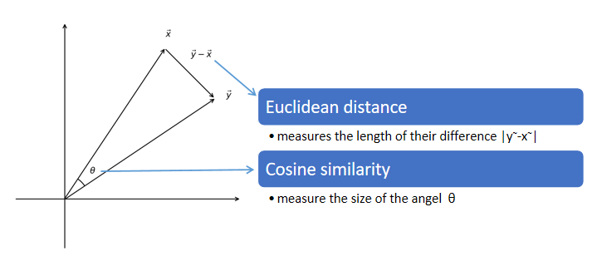
Vector Space Characteristics
The correlation between two vectors in a high-dimensioned space.

Slide 20
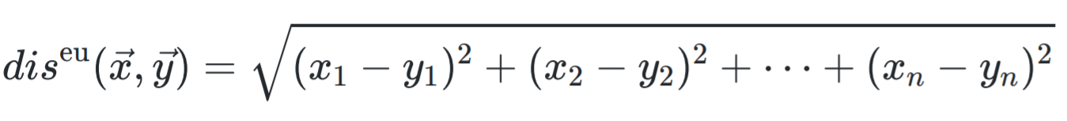
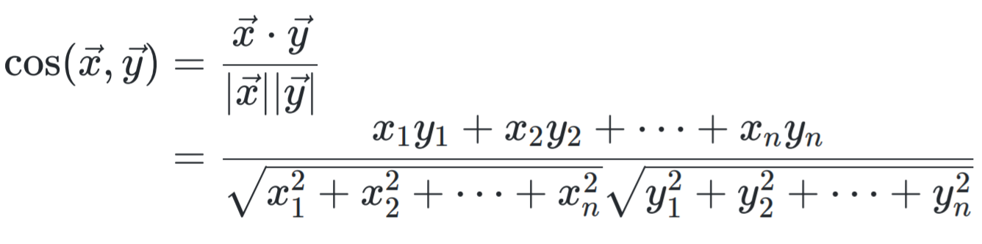
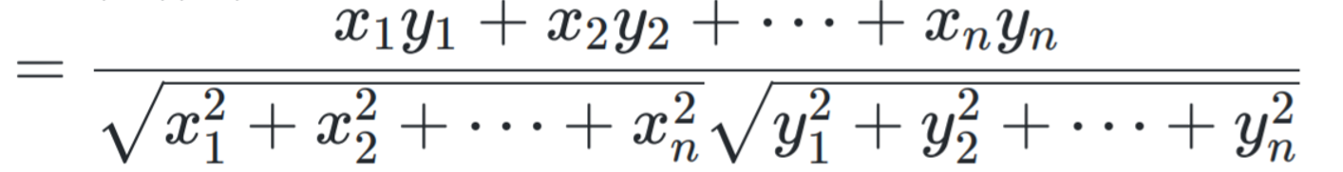
Vector Space Distance
$$\vec{X}=\left\langle x_{1}, x_{2}, …, x_{n}\right\rangle \vec{Y}=\left\langle y_{1}, y_{2}, …, y_{n}\right\rangle$$
Euclidean distance
Cosine similarity

Slide 21
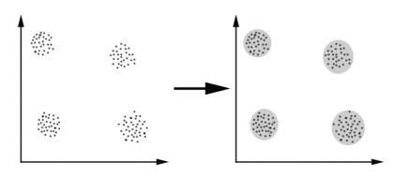
Clustering
To find groups of vectors that stay relatively close to each other, using Euclidean distance as the metric.

Slide 22
Clustering
To find groups of vectors that stay relatively close to each other, using Euclidean distance as the metric.
Challenges.
the number of clusters?
the cluster assignment? center?

Slide 23
Contents
4.1 Representing Documents in Vector Spaces
4.1.1 Clustering
4.1.2 K-Means Clustering
4.1.3 Classification
4.1.4 Support Vector Machine
4.1.5 Perceptron
4.2 Multi-class Classification
4.2.1 Defining Output-based Features
4.2.2 Multi-class SVM
4.3.3 Multi-class Perceptron
4.3 Discriminative Models and Features
4.3.1 Discriminative Models and Features
4.3.2 Dot-product Form of Linear Models
4.3.3 Separability and Generalizability
4.3.4 Dealing with Non-linearly-separable data

Slide 24
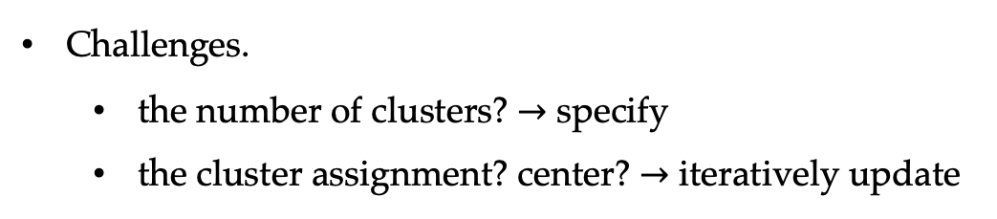
Clustering
To find groups of vectors that stay relatively close to each other, using Euclidean distance as the metric.
Challenges.
the number of clusters? $→$ specify
the cluster assignment? center? $→$ iteratively update

Slide 25
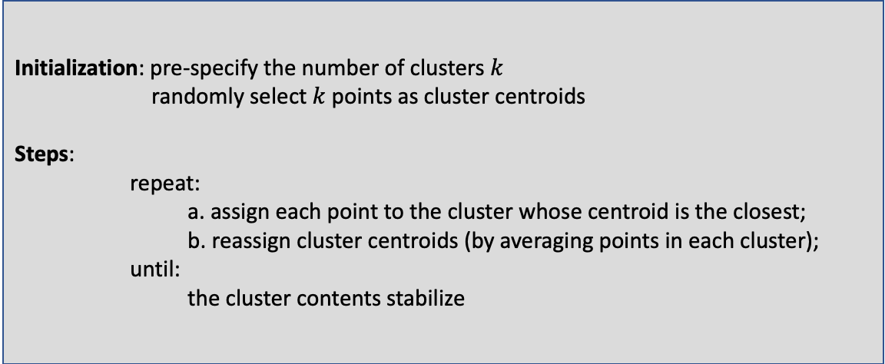
K-means Clustering
Iteratively assigns points to clusters based on their distance to the centroids.
Initialization: pre-specify the number of clusters $k$
randomly select $k$ points as cluster centroids
Steps:
repeat:
a. assign each point to the cluster whose centroid is the closest;
b. reassign cluster centroids (by averaging points in each cluster);
until:
the cluster contents stabilize
Notes:
algorithm 3.1

Slide 26
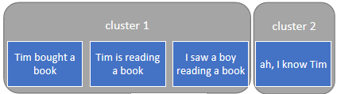



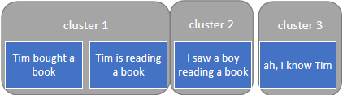

K-means Clustering
2-Means
Documents
3-Means

Slide 27
Contents
4.1 Representing Documents in Vector Spaces
4.1.1 Clustering
4.1.2 K-Means Clustering
4.1.3 Classification
4.1.4 Support Vector Machine
4.1.5 Perceptron
4.2 Multi-class Classification
4.2.1 Defining Output-based Features
4.2.2 Multi-class SVM
4.3.3 Multi-class Perceptron
4.3 Discriminative Models and Features
4.3.1 Discriminative Models and Features
4.3.2 Dot-product Form of Linear Models
4.3.3 Separability and Generalizability
4.3.4 Dealing with Non-linearly-separable data

Slide 28
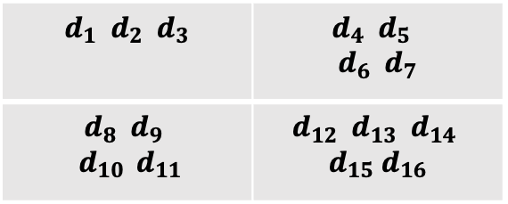
Clustering vs. Classification
My emails
Travel Non-travel
Work
Leisure
$$d_{1} d_{2} d_{3}$$ | $$d_{4} d_{5}$$ $$d_{6} d_{7}$$
$$d_{8} d_{9}$$ $$d_{10 } d_{11}$$ | $$d_{12} d_{13} d_{14}$$ $$d_{15} d_{16}$$

Slide 29
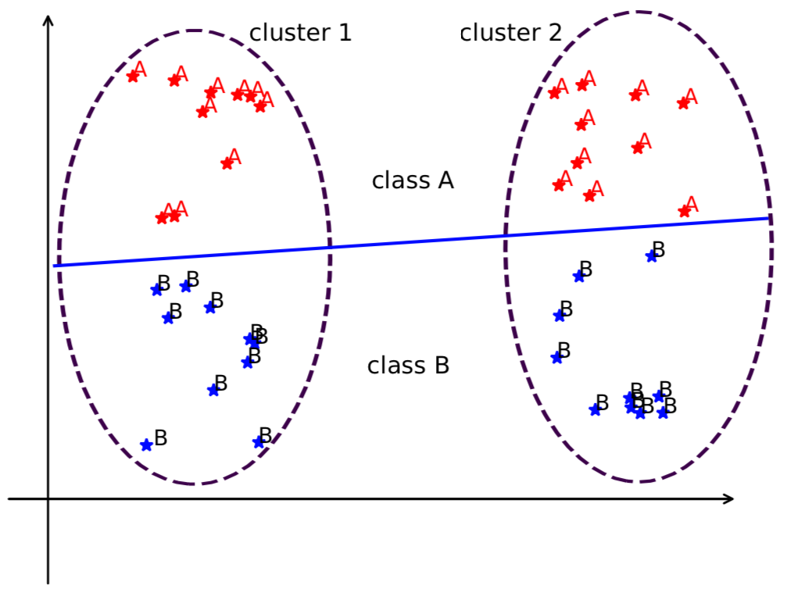
Clustering vs. Classification
Clustering vs classification.
Notes:
add example
figure 3.2
hyper-plane: generalization of a line in high-dim space

Slide 30
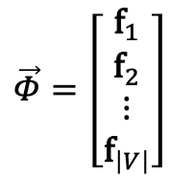
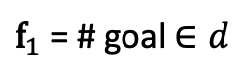
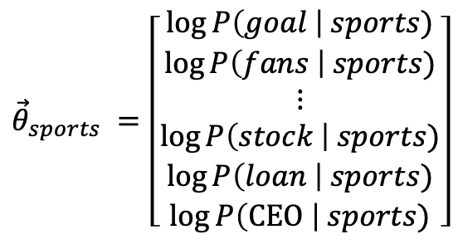
Clustering vs. Classification
Parameters are the key to control the separator.
$${\vec{θ}}_{sports} =\left[\begin{aligned}\begin{aligned}\log{P\left(goal \right| sports)} \\ \log{P\left(fans \right| sports)} \\ ⋮ \\ \log{P\left(stock \right| sports)} \\ \log{P\left(loan \right| sports)}\end{aligned} \\ \log{P\left(\text{CEO} \right| sports)}\end{aligned}\right]$$
$$\vec{Φ}=\left[\begin{aligned}{\text{f}}_{1} \\ {\text{f}}_{2} \\ ⋮ \\ {\text{f}}_{\left|V\right|}\end{aligned}\right]$$
${\text{f}}_{1}$ = # goal $∈d$
$$\log{P\left(c=sports | d\right)}={\vec{θ}}_{sports}∙\vec{Φ}+\log{P\left(c=sports\right)}$$

Slide 31
Clustering vs. Classification
Clustering (unsupervised learning)
Do not require manually labeled training data
All words have equal importance in a document vector
Difficult to ensure customized vector division
Classification (supervised learning)
Requires training data with manual class labels
Pick up the important words for classification tasks
Use model parameters to define space separation

Slide 32
Contents
4.1 Representing Documents in Vector Spaces
4.1.1 Clustering
4.1.2 K-Means Clustering
4.1.3 Classification
4.1.4 Support Vector Machine
4.1.5 Perceptron
4.2 Multi-class Classification
4.2.1 Defining Output-based Features
4.2.2 Multi-class SVM
4.3.3 Multi-class Perceptron
4.3 Discriminative Models and Features
4.3.1 Discriminative Models and Features
4.3.2 Dot-product Form of Linear Models
4.3.3 Separability and Generalizability
4.3.4 Dealing with Non-linearly-separable data

Slide 33
Vector Space View of Classification Task
Finding the hyperplane
Notes:
add example
figure 3.2
hyper-plane: generalization of a line in high-dim space

Slide 34
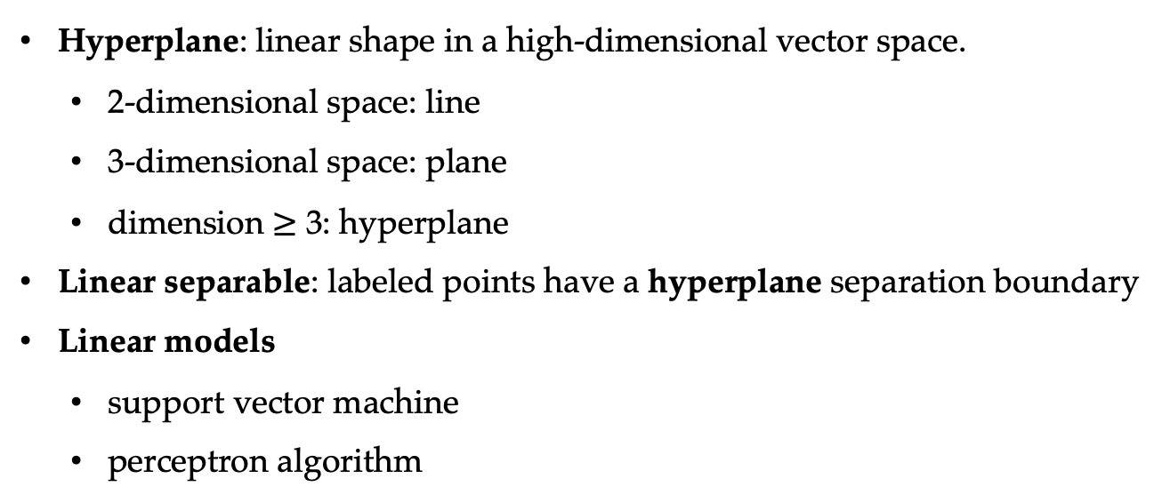
Linear Separability
Hyperplane: linear shape in a high-dimensional vector space.
2-dimensional space: line
3-dimensional space: plane
dimension $≥$ 3: hyperplane
Linear separable: labeled points have a hyperplane separation boundary
Linear models
support vector machine
perceptron algorithm

Slide 35
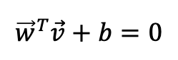
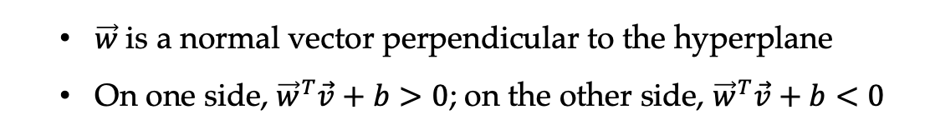
Support Vector Machine (SVM)
Modeling target: given a point, decide which side of a hyperplane it resides.
Parameterization: defining the hyperplane
$${\vec{w}}^{T}\vec{v}+b=0$$
$\vec{w}$is a normal vector perpendicular to the hyperplane
On one side, ${\vec{w}}^{T}\vec{v}+b>0$; on the other side, ${\vec{w}}^{T}\vec{v}+b<0$

Slide 36
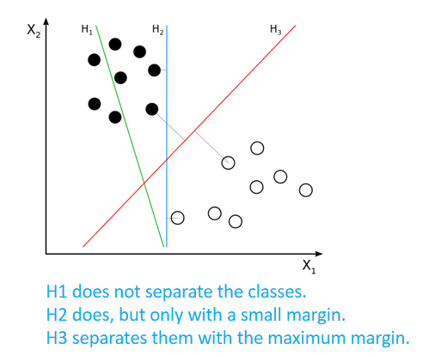
Support Vector Machine (SVM)
Training — find the hyperplane from labeled data.
Support vectors: points
closest to the separating hyperplane
Margins: Support vector distances to the hyperplane
Training goal: find the hyperplane that maximizes the margins
SVM hyperplane
Support vectors
Margins
Notes:
libsvm
safe cut
margin: distance from point to plane

Slide 37
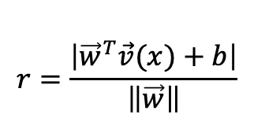
Support Vector Machine (SVM)
Distance between vectors to the hyperplane:
$$r=\frac{\left|{\vec{w}}^{T}\vec{v}(x)+b\right|}{\left\|\vec{w}\right\|}$$
SVM hyperplane
Support vectors
Training goal — maximize the distance between support vectors and the hyperplane.
Margins

Slide 38

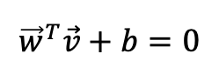
Parameterising the Model
Wait …
There is an infinite amount of ($\vec{w}$, 𝑏) pairs to define each hyperplane
$${\vec{w}}^{T}\vec{v}+b=0$$
SVM hyperplane
Support vectors
Margins

Slide 39
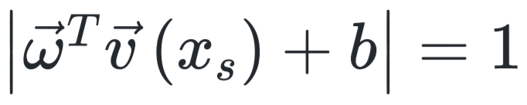
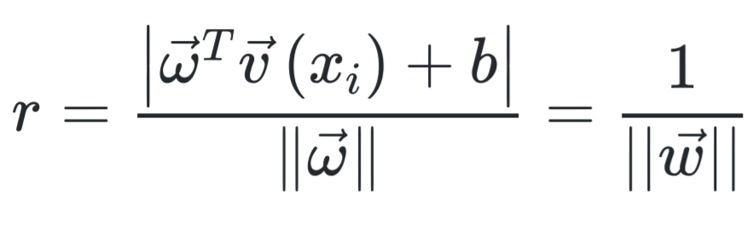
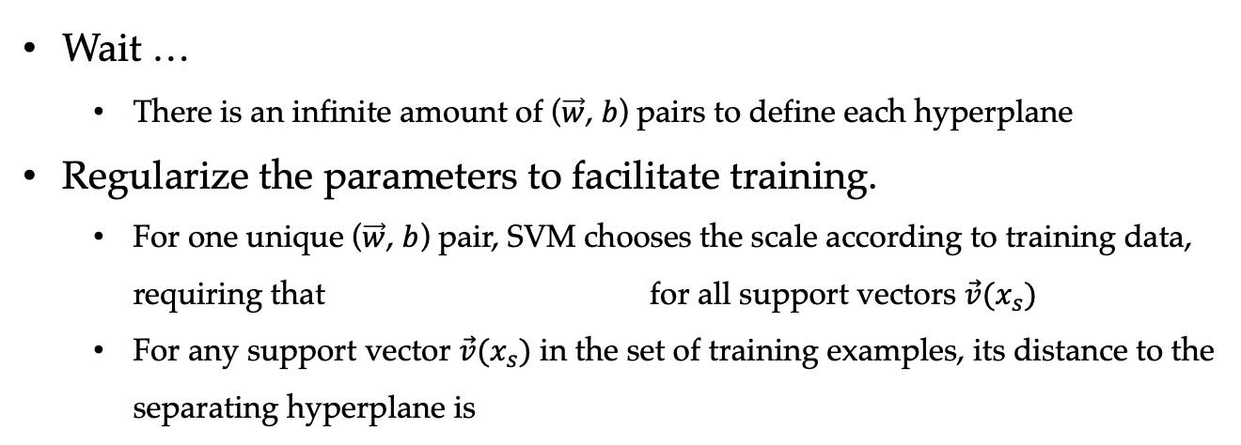
Parameterising the Model
Wait …
There is an infinite amount of ($\vec{w}$, 𝑏) pairs to define each hyperplane
Regularize the parameters to facilitate training.
For one unique ($\vec{w}$, $b$) pair, SVM chooses the scale according to training data, requiring that for all support vectors $\vec{v}(x_{s})$
For any support vector $\vec{v}(x_{s})$ in the set of training examples, its distance to the separating hyperplane is
$${\vec{w}}^{T}\vec{v}+b=0$$
SVM hyperplane
Support vectors
Margins

Slide 40
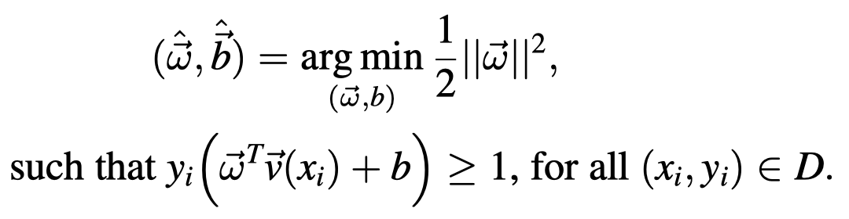
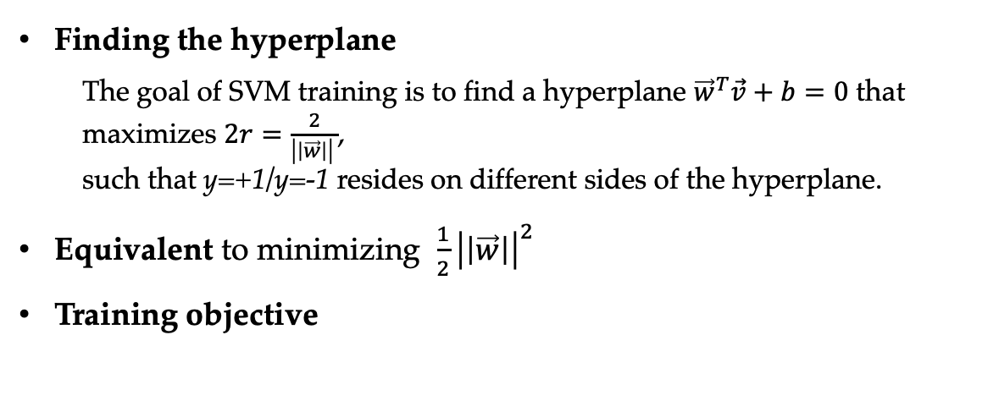
SVM Training
Finding the hyperplane
The goal of SVM training is to find a hyperplane ${\vec{w}}^{T}\vec{v}+b=0$ that maximizes $2r=\frac{2}{\left|\left|\vec{w}\right|\right| }$,
such that y=+1/y=-1 resides on different sides of the hyperplane.
Equivalent to minimizing $\frac{1}{2}{\left|\left|\vec{w}\right|\right|}^{2}$
Training objective

Slide 41
SVM Training
Finding the hyperplane
The goal of SVM training is to find a hyperplane ${\vec{w}}^{T}\vec{v}+b=0$ that maximizes $2r=\frac{2}{\left|\left|\vec{w}\right|\right| }$,
such that y=+1/y=-1 resides on different sides of the hyperplane.
Equivalent to minimizing $\frac{1}{2}{\left|\left|\vec{w}\right|\right|}^{2}$
Training objective
Constrained optimization without closed form solution
We will discuss it next week.

Slide 42
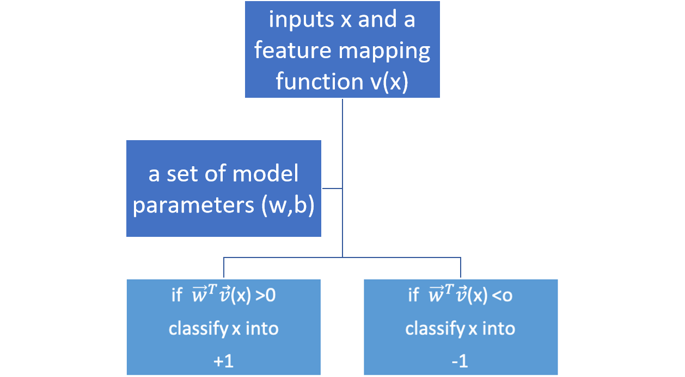
Test Scenarios

Slide 43
Contents
4.1 Representing Documents in Vector Spaces
4.1.1 Clustering
4.1.2 K-Means Clustering
4.1.3 Classification
4.1.4 Support Vector Machine
4.1.5 Perceptron
4.2 Multi-class Classification
4.2.1 Defining Output-based Features
4.2.2 Multi-class SVM
4.3.3 Multi-class Perceptron
4.3 Discriminative Models and Features
4.3.1 Discriminative Models and Features
4.3.2 Dot-product Form of Linear Models
4.3.3 Separability and Generalizability
4.3.4 Dealing with Non-linearly-separable data

Slide 44
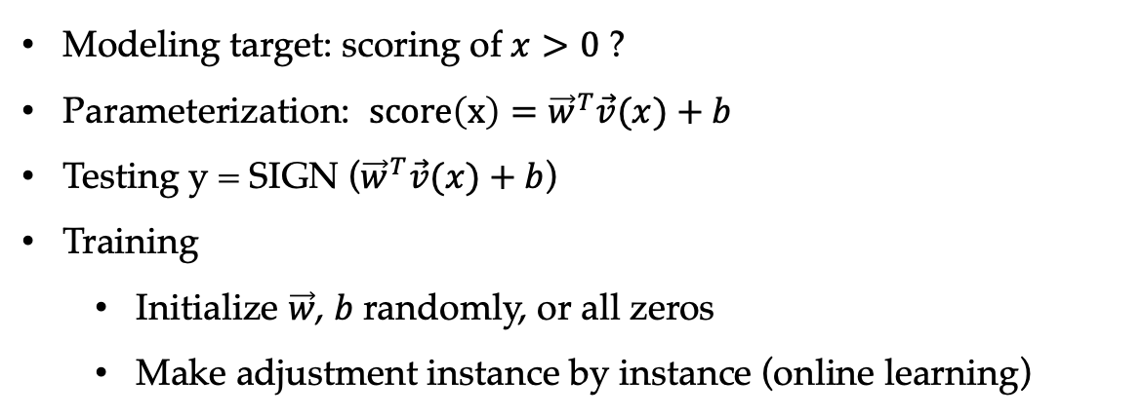
The Perceptron Algorithm
Modeling target: scoring of $x>0$ ?
Parameterization: $score\left(x\right)={\vec{w}}^{T}\vec{v}(x)+b$
Testing y = SIGN (${\vec{w}}^{T}\vec{v}(x)+b$)
Training
Initialize $\vec{w}$, $b$randomly, or all zeros
Make adjustment instance by instance (online learning)

Slide 45

The Perceptron Algorithm
Online Learning. —— given gold $\left(x,y\right)$ instances.
Initialization: set $\vec{w}$ to $\vec{0}$ , b to 0
Steps:
repeat:
calculate a current output $z$for each input $x$ in the training set
if the output $y$ is different from the gold output $y$:
Adjust the model parameter $\vec{w}$ by adding $\vec{v}(x)$ if $y$ = +1
subtracting $\vec{v}(x)$ if $y$ = -1
Adjust b by adding 1if $y$ = +1
subtracting 1 if $y$ = -1
until:
a certain iteration number is reached.
Notes:
algorithm 3.1

Slide 46


Perceptron Update
vector space interpretation
If the correct training example $\vec{v}(x_{i}^{+})$ falls on the wrong side of the hyperplane, the perceptron update changes the normal vector $\vec{w}$ towards $\vec{v}(x_{i}^{+})$, and changes b by 1.

Slide 47

Numerical Interpretation
Given a model $\left(\vec{ω},b\right).$
The current instance $x_{i}^{+}$has ${\vec{ω}}^{T}x_{i}^{+}+b<0$.
The new model becomes $\left(\vec{ω}+\vec{v}(x_{i}^{+}),b+1\right)$ after the update.
The new score is ${\left(\vec{ω}+\vec{v}\left(x_{i}^{+}\right)\right)}^{T}\vec{v}\left(x_{i}^{+}\right)+b+1=\left({\vec{ω}}^{T}\vec{v}\left(x_{i}^{+}\right)+b\right)+{\left(\vec{v}\left(x_{i}^{+}\right)\right)}^{2}+1$, which is larger than the old score ${\vec{ω}}^{T}\vec{v}\left(x_{i}^{+}\right)+b$.
Thus $x_{i}^{+}$ will be more likely on the positive side of the new hyperplane.

Slide 48
Contents
4.1 Representing Documents in Vector Spaces
4.1.1 Clustering
4.1.2 K-Means Clustering
4.1.3 Classification
4.1.4 Support Vector Machine
4.1.5 Perceptron
4.2 Multi-class Classification
4.2.1 Defining Output-based Features
4.2.2 Multi-class SVM
4.3.3 Multi-class Perceptron
4.3 Discriminative Models and Features
4.3.1 Discriminative Models and Features
4.3.2 Dot-product Form of Linear Models
4.3.3 Separability and Generalizability
4.3.4 Dealing with Non-linearly-separable data

Slide 49
Solutions Towards Multi-class Classification
One-vs-rest approaches
a hyperplane separates out a particular class of document from the rest
Pairwise approaches
More principled solutions
One linear model
Notes:
add figure 3.5

Slide 50
Solutions Towards Multi-class Classification
One-vs-rest approaches
a hyperplane separates out a particular class of document from the rest
Pairwise approaches
More principled solutions
One linear model
Can you cut a vector space into 3 parts?
Notes:
add figure 3.5

Slide 51
Contents
4.1 Representing Documents in Vector Spaces
4.1.1 Clustering
4.1.2 K-Means Clustering
4.1.3 Classification
4.1.4 Support Vector Machine
4.1.5 Perceptron
4.2 Multi-class Classification
4.2.1 Defining Output-based Features
4.2.2 Multi-class SVM
4.3.3 Multi-class Perceptron
4.3 Discriminative Models and Features
4.3.1 Discriminative Models and Features
4.3.2 Dot-product Form of Linear Models
4.3.3 Separability and Generalizability
4.3.4 Dealing with Non-linearly-separable data

Slide 52
Multi-class Classification
Vector space is separated into correct output and incorrect output subspaces.
the ratio between the numbers of positive and negative examples is constantly (1 : |C| - 1).
Multi-class classification (★ and ● are two documents, c₁ , c₂ and c₃ are three class labels. The gold label for ★ is c₁ and the gold label for ● is c₂.)

Slide 53



Output-based Features
Input feature vector :
Input-output feature vector :
NOTE : x – input, c – class
Cartesian product (count-based vector $\vec{v}(d)$ for example)
$\vec{v}\left(d\right)=⟨\#w_{1},w_{2},…,w_{|v|}⟩$

Slide 54





Output-based Features
Document: Tim went to Amsterdam to meet Jason
Label: Work
Output-based features:
Tim
meet
$$\vec{v}\left(d,c\right)=<0, 0, ⋯, 0, 1, 0, 1, ⋯, 0,$$
$← c_{1}=$ Work
$$0, 0, ⋯, ⋯, ⋯, 0>$$
$← c_{2}=$ Leisure (all zeros!)

Slide 55
Contents
4.1 Representing Documents in Vector Spaces
4.1.1 Clustering
4.1.2 K-Means Clustering
4.1.3 Classification
4.1.4 Support Vector Machine
4.1.5 Perceptron
4.2 Multi-class Classification
4.2.1 Defining Output-based Features
4.2.2 Multi-class SVM
4.3.3 Multi-class Perceptron
4.3 Discriminative Models and Features
4.3.1 Discriminative Models and Features
4.3.2 Dot-product Form of Linear Models
4.3.3 Separability and Generalizability
4.3.4 Dealing with Non-linearly-separable data

Slide 56





Multi-class SVM
Modeling target $score\left(x,c\right)=\vec{w}\vec{v}\left(x,c\right)+b$, such that
Training samples:
Derive training instances
Positive instances: $\vec{v}(x_{i},c_{i})$
Negative instances : $\vec{v}(x_{i},c)$, where $c≠c_{i}$
Training objective:
Test time find the class as
$score\left(x,c\right)>0$ if correct
$score\left(x,c\right)<0$ if incorrect

Slide 57



Multi-class SVM
Modeling target $score\left(x,c\right)=\vec{w}\vec{v}\left(x,c\right)+b$, such that
$score\left(x,c\right)>0$ if correct
$score\left(x,c\right)<0$ if incorrect
Training examples:
Training objective:
Test time find the class as

Slide 58
Multi-class SVM
Modeling target $score\left(x,c\right)=\vec{w}\vec{v}\left(x,c\right)+b$, such that
$score\left(x,c\right)>0$ if correct
$score\left(x,c\right)<0$ if incorrect
Training examples:
Training objective:
Test time find the class as
Too strict?

Slide 59



Linear Models as Scoring Functions
Test time find the class as
In a score perspective:
Given a test input $x$, the model finds the class label $\hat{c}$ with the highest score as the output:
Final form of multi-class SVM training objective
Notes:
equation 3.8

Slide 60
Contents
4.1 Representing Documents in Vector Spaces
4.1.1 Clustering
4.1.2 K-Means Clustering
4.1.3 Classification
4.1.4 Support Vector Machine
4.1.5 Perceptron
4.2 Multi-class Classification
4.2.1 Defining Output-based Features
4.2.2 Multi-class SVM
4.3.3 Multi-class Perceptron
4.3 Discriminative Models and Features
4.3.1 Discriminative Models and Features
4.3.2 Dot-product Form of Linear Models
4.3.3 Separability and Generalizability
4.3.4 Dealing with Non-linearly-separable data

Slide 61

Multi-class Perceptron
Modeling target
$$score\left(x,c\right)={\vec{w}}^{T}\vec{v}(x,c)$$
Testing
$$c=arg\max_{c^{′}∈C}{score(x,c^{′})}$$
Training
initialize $\vec{w}$ randomly, or all zeros
make adjustments instance by instance
Notes:
algorithm 3.3
add proof

Slide 62

Multi-class Perceptron
Online Learning. —— given gold $\left(x,c\right)$ instances.
Initialization: set $\vec{w}$ to $\vec{0}$ , b to 0
Steps:
repeat:
for each input $x$ in the training set calculate a current output $z$
if the output $z$ is different from the gold output $c$:
$\vec{w}←\vec{w}+\vec{v}\left(x,c\right)−\vec{v}\left(x,z\right)$
until:
a certain iteration number is reached.
Notes:
algorithm 3.3
add proof

Slide 63

Multi-class Perceptron
Given a model $\vec{ω}$,
The current instance $x_{i}^{+}$ has $\vec{ω}∙\vec{v} \left(x_{i}, z\right)>\vec{ω}∙\vec{v} \left(x_{i}, c_{i}\right)$
Model parameters become $\vec{ω}+\vec{v} \left(x_{i}, c_{i}\right)−\vec{v} \left(x_{i}, z\right)$ after the update.
The new score difference $\left(\vec{ω}+\vec{v} \left(x_{i}, c_{i}\right)−\vec{v} \left(x_{i}, z\right)\right)∙v\left(x_{i}, z\right)−\left(\vec{ω}+\vec{v} \left(x_{i}, c_{i}\right)−\vec{v} \left(x_{i}, z\right)\right)∙v\left(x_{i}, c_{i}\right)$= $\vec{ω}\left(\vec{v} \left(x_{i}, z\right)−\vec{v} \left(x_{i}, c_{i}\right)\right)−{(\vec{v} \left(x_{i}, z\right)−\vec{v} \left(x_{i}, c_{i}\right))}^{2}$ < $\vec{ω}\left(\vec{v} \left(x_{i}, z\right)−\vec{v} \left(x_{i}, c_{i}\right)\right)$
More likely being correct.
Notes:
algorithm 3.3
add proof

Slide 64
Contents
4.1 Representing Documents in Vector Spaces
4.1.1 Clustering
4.1.2 K-Means Clustering
4.1.3 Classification
4.1.4 Support Vector Machine
4.1.5 Perceptron
4.2 Multi-class Classification
4.2.1 Defining Output-based Features
4.2.2 Multi-class SVM
4.3.3 Multi-class Perceptron
4.3 Discriminative Models and Features
4.3.1 Discriminative Models and Features
4.3.2 Dot-product Form of Linear Models
4.3.3 Separability and Generalizability
4.3.4 Dealing with Non-linearly-separable data

Slide 65
Discriminative Models
Both SVM and perceptron are discriminative models They work by differentiating positive examples and negative examples, (for binary classification y=+1/y=-1; for multi-class classification c) assigning higher scores to positive examples
Naïve Bayes is a generative model, calculating joint probabilities of inputs and outputs
All the three models are linear models
Notes:
parameter type -> feature template
instance ...

Slide 66
Clustering vs. Classification
Parameters are the key to control the separator.
$${\vec{θ}}_{sports} =\left[\begin{aligned}\begin{aligned}\log{P\left(goal \right| sports)} \\ \log{P\left(fans \right| sports)} \\ ⋮ \\ \log{P\left(stock \right| sports)} \\ \log{P\left(loan \right| sports)}\end{aligned} \\ \log{P\left(\text{CEO} \right| sports)}\end{aligned}\right]$$
$$\vec{Φ}=\left[\begin{aligned}{\text{f}}_{1} \\ {\text{f}}_{2} \\ ⋮ \\ {\text{f}}_{\left|V\right|}\end{aligned}\right]$$
${\text{f}}_{1}$ = # goal $∈d$
$$\log{P\left(c=sports | d\right)}={\vec{θ}}_{sports}∙\vec{Φ}+\log{P\left(c=sports\right)}$$

Slide 67




Naïve Bayes has a Class Feature
$${\vec{θ}}_{sports} =\left[\begin{aligned}\begin{aligned}\begin{aligned}\log{P(sports)} \\ \log{P\left(goal \right| sports)}\end{aligned} \\ \log{P\left(fans \right| sports)} \\ ⋮ \\ \log{P\left(stock \right| sports)} \\ \log{P\left(loan \right| sports)}\end{aligned} \\ \log{P\left(\text{CEO} \right| sports)}\end{aligned}\right]$$
$$\vec{Φ}=\left[\begin{aligned}\begin{aligned}1 \\ {\text{f}}_{1}\end{aligned} \\ {\text{f}}_{2} \\ ⋮ \\ {\text{f}}_{\left|V\right|}\end{aligned}\right]$$
${\text{f}}_{1}$ = # goal $∈d f_{0}$=1
$$\log{P\left(c=sports | d\right)}={\vec{θ}}_{sports}∙\vec{Φ}$$

Slide 68


Adding Class Feature to SVM and Perceptron

Slide 69


Naïve Bayes
$$\log{P\left(c | d\right)}=\log{P\left(c\right)}+\sum_{w∈d}{\log{P(w|c)}}$$

Slide 70


Discriminative Model vs. Generative Model
Parameter types P(c), P(w|c) and parameter instances P(sports), P(goal|sports)
Feature vectors are assembly of parameter instances. But we can add more parameter types into our feature vectors
$\vec{v}\left(d,c\right)=\left\langle w_{1}c, w_{2}c,…, w_{\left|V\right|}c\right\rangle ⇒ \vec{v}\left(d,c\right)=\left\langle c_{1}, c_{2}, …, c_{\left|C\right|}, w_{1}c, w_{2}c,…, w_{\left|V\right|}c\right\rangle$
Advantage of discriminative models:
using overlapping features, such as word and bigram features.
Notes:
add class; add control of priors;
more details about the difference

Slide 71

Bigram Features
Bigram features are useful for text classification, they offer more specific information about text classes.
Bigrams are sparser making the feature vector longer and more sparse.
Notes:
overlapping features

Slide 72

Bigram Features
As in the example from textbook, with bigram features, the feature vector for the sentence “Tim bought a book" in Table 3.1 is
Notes:
parameter type -> feature template
instance ...

Slide 73

Bigram Features
Notes:
parameter type -> feature template
instance ...

Slide 74
Feature Templates and Instances
Feature extraction:
A process of matching feature templates to output structures and instantiating them into feature instances.
Feature templates: similar to parameter type; in examples above, there are three templates, namely c, wc and w_{i-1}w_{i}c
Feature instances: similar to parameter instance; e.g., Work, Jason|Work
Notes:
parameter type -> feature template
instance ...

Slide 75
Contents
4.1 Representing Documents in Vector Spaces
4.1.1 Clustering
4.1.2 K-Means Clustering
4.1.3 Classification
4.1.4 Support Vector Machine
4.1.5 Perceptron
4.2 Multi-class Classification
4.2.1 Defining Output-based Features
4.2.2 Multi-class SVM
4.3.3 Multi-class Perceptron
4.3 Discriminative Models and Features
4.3.1 Discriminative Models and Features
4.3.2 Dot-product Form of Linear Models
4.3.3 Separability and Generalizability
4.3.4 Dealing with Non-linearly-separable data

Slide 76




Dot-product Form of Linear Models
A general form of a linear model :
Given an input $x$, its score is computed by
Parameter vector (weight vector)
Feature vector

Slide 77

Dot-product Form of Linear Models
A general form of a linear model :
Given an input $x$, its score is computed by
Parameter vector (weight vector)
Feature vector
Effectively same as having $score\left(x,c\right)= \vec{θ_{c}}∙\vec{φ}\left(x\right).$

Slide 78
Contents
4.1 Representing Documents in Vector Spaces
4.1.1 Clustering
4.1.2 K-Means Clustering
4.1.3 Classification
4.1.4 Support Vector Machine
4.1.5 Perceptron
4.2 Multi-class Classification
4.2.1 Defining Output-based Features
4.2.2 Multi-class SVM
4.3.3 Multi-class Perceptron
4.3 Discriminative Models and Features
4.3.1 Discriminative Models and Features
4.3.2 Dot-product Form of Linear Models
4.3.3 Separability and Generalizability
4.3.4 Dealing with Non-linearly-separable data

Slide 79
Separability and Generalizability
Feature engineering : the process of defining a useful set of features
more feature reflect richer information
better designed feature vectors allow better linear separability
Separability
linear separable
dataset can be largely linear separable given proper feature definitions
Generalization
overfitting
underfitting

Slide 80
Contents
4.1 Representing Documents in Vector Spaces
4.1.1 Clustering
4.1.2 K-Means Clustering
4.1.3 Classification
4.1.4 Support Vector Machine
4.1.5 Perceptron
4.2 Multi-class Classification
4.2.1 Defining Output-based Features
4.2.2 Multi-class SVM
4.3.3 Multi-class Perceptron
4.3 Discriminative Models and Features
4.3.1 Discriminative Models and Features
4.3.2 Dot-product Form of Linear Models
4.3.3 Separability and Generalizability
4.3.4 Dealing with Non-linearly-separable data

Slide 81
Non-Linearly-Separable Data
c₂
c₁
c₁
c₂
c₁
c₃
c₃
c₂
c₃
Multi-class classification (★ , and ● are three documents, c₁ , c₂ and c₃ are three class labels. The gold label for ★ is c₁ and the gold label for ● is c₂, and The gold label for is c₃ )
Notes:
ha

Slide 82




Binary SVM
Slack variables $ξ$
Training objective
$$∴$$
Notes:
ha

Slide 83

Multi-class SVM
Training objective with slack variables :

Slide 84


Multi-class SVM
Training objective with slack variables :

Slide 85
Perceptron
In the case where the training data are not linearly separable, the perceptron can still converge to a model that gives reasonably small numbers of training errors.

Slide 86
Summary
Vector representations of documents
Support vector machine and perceptron
Vector representations of input-output pairs
Multi-class SVMs and perceptions
Discriminative models vs generative models
The importance of features to the separability of training data and generalization to test data

